Slide 1
The academic track
(BIMM05 + BIMM81)
Introductory meeting
March 5th 2024
Chris
christopher.douse@med.lu.se
Nick
nicholas.leigh@med.lu.se
Transposons, epigenetics and brain development
Regenerative Immunology

Slide 2
Who is the academic track for?
Everyone!
There are great labs at LU doing top notch science
High level of freedom
Potential to set up path to a PhD position
Can always switch gears to industry

Slide 3
BIMM05
Aim for the course: prepare you for an academic research project (BIMM81)
Mission of Nick and Chris: empower you to thrive in your host lab and enjoy your project
5 modules across 4 weeks:
project initiation
academic group dynamics
data documentation
time and cost management
how and when to publish

Slide 4
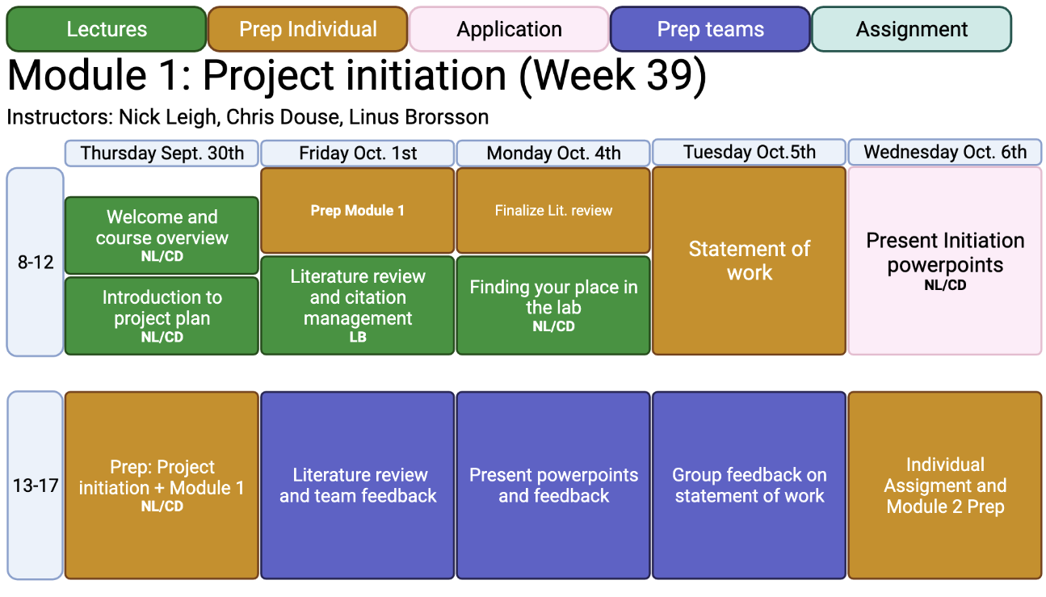
Example module structure

Slide 5
BIMM05 assessment
each module has 1-2 assignments
these are ungraded, but you receive feedback on each
at the end of the course, you put together all the assignments in a (graded) portfolio
our intention is that these are useful documents, e.g. literature review
Key to emphasize today
to get the most from this course, you must know a bit about your project already
therefore we strongly encourage you to contact supervisors ASAP!

Slide 6
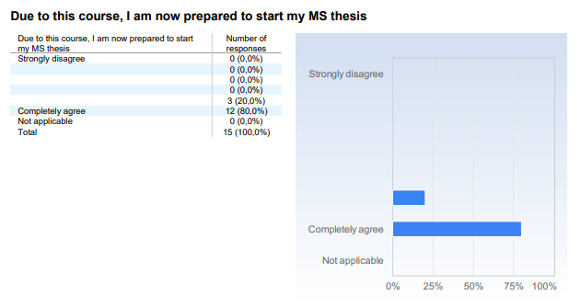
Feedback from the previous cohort

Slide 7
Approx timeline
Have some information about the project and 3 key papers
Project starts
Project ends
peer review of introduction
May 2024
Sept 2024
Oct 2024
Nov 2024
Mar/Apr 2025
May 2025
BIMM05
BIMM81
Identify a host research lab
Thesis defence
end of May
(submit at least 2 weeks before)

Slide 8
Questions?

